Slide 1
SEMINAR ON “DATA ANALYSIS”
GUIDED BY
DR. VINOD SIR
PRESENTED BY
MR.SUMAN KUMAR MISS. ANUJA SALVI
MR. ROHIT CHANDRA MISS. ASHWINI TICHKULE
MR. ROHIT SANJAI MR. ASHISH TIWARI

Slide 2
Introduction
1459 obs. of 80 variables

Slide 3
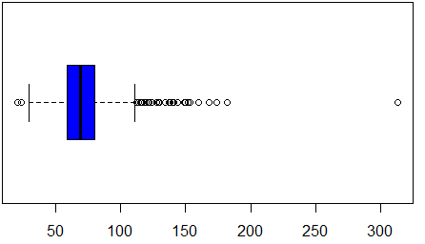
Dataset analysis and enrichment
> describe(PPT) -> kurtosis, skew, se
>str(PPT)
Dataset missing values have been populated using kNN function.
Some outliers are present in dataset which has been replaced with upper and lower threshold value.
Boxplot for Lot_Extent

Slide 4
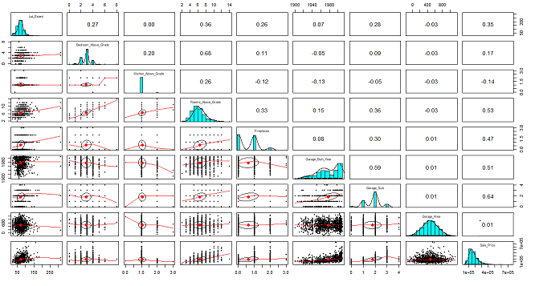
Correlation of predictors
pairs.panels: Normal Distribution, correlation of Numeric variables

Slide 5
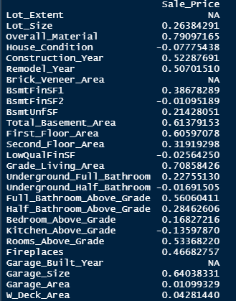
Correlation and column selections

Slide 6
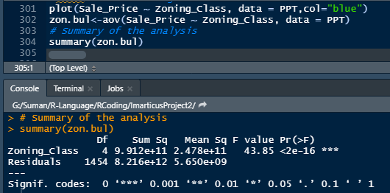
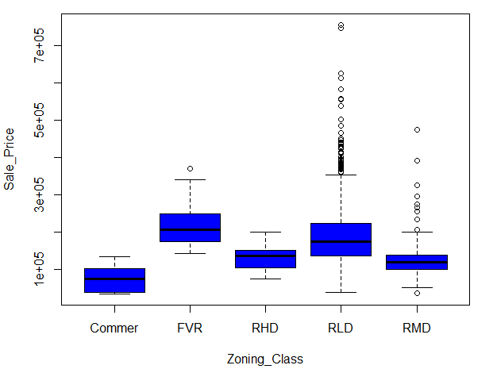
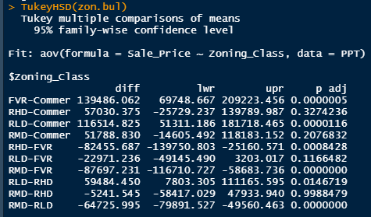
Anova test-categorical variable

Slide 7
Linear models

Slide 9
Summary
Average, Minimum and Maximum level of nutrients from the provided the dataset
Model | Predictors | R Square

Slide 10
Thank You…
Project Website: EDA Cereals Proj
https://imarticsproject.wixsite.com/edacerealsproj

